Slide 1
LiVING the patient experience
“Be the patient”
“Healthcare is a business – but not to the patient or their family’
Patient Financial navigator foundation’s Mission -
“Transforming the hassle factor – one patient, one family, one employer, one community at a time….thru education”

Slide 2
Paying it forward – The power of One
We can make a difference… isn’t that why we are in healthcare?
In 2017, we formed an Idaho-based, Family Foundation:
  The Patient Financial Navigator Foundation Pfnfinc.com All material – Free!
  Mission: To transform the hassle factor in healthcare – one patient, one family, one employer, one community at a time…thru education.
  Host regional 3x yearly ‘Medicare 101, Social Security and Assistance for Seniors” Boot camp. NO cost. Working with many local healthcare contributors/faculty and the local college.
  Write ‘Health Care Buzz’ for a regional newspaper
  Continue to reach out to employers – ‘Wellness Luncheons’ – and the Small Business Groups
  Highlight Women in Leadership - Celebrate!
  High school seniors – next generation of engaged healthcare adults. Need taught!
  Free webinars and speaking to associations on how they can be the change makers…free!
  Be the example you want healthcare to look like – The power of One.. Creativity!

Slide 3
Healthcare is personal.
WALK THRU THE INTERNAL REVENUE CYCLE
AND LOOK FOR WHERE PATIENTS GET ‘LOST.’
Patients come to a healthcare provider
Scared, their live has been disrupted and they don’t know where the money will come from to pay their medical bills.
Once the patient is ‘ill’ or has had an accident, all energy is with the patient and family.
Who is the advocate to help them navigate the internal systems? How will they even know? Lost and scared.
What about the ongoing conversation – what is happening?
Let’s look inside – beyond the initial ‘crisis of the moment’ – and see what healthcare looks like …
To the Patient
To the Family
What happens now? Ps just because a family is present, they are easily highly upset and just as lost as the pt.
Patients don’t access hospitals –rarely. All new!

Slide 4
1) The patient arrives in the ER. Family or a friend or maybe the pt came alone
All the ‘admission’ forms need completed. Nursing has to do a complete assessment. The doctor/mid-level re-asks –just to be sure it was complete.
Time passes while the pt is waiting to hear – what is wrong? Tons of pain.. Scared.
When the results finally come back, - “good, you can go home/see your primary care doctor/discharge instructions. (what if the pt doesn’t understand?) Get your prescription and thanks for coming! “ (A little humor!)
OR - they are ‘accepted’ by the hospitalists –another stranger to the pt. They are told they are being admitted to the hospital – pending approval by their insurance. WHAT?

Slide 5
2) Now the patient is an inpt or is it observation and what does that mean to the patient? What is a hospitalist?
This is when it gets extremely difficult to be a patient in the healthcare system.
Another complete nursing work up, another doctor asking the same questions, another set of new forms/The Important Medicare, moved from the ER ‘eventually’ to the floor. Placed in room 204. (How would the pt know they are OBS today vs inpt? They are in room 204. Insurance pays differently.)
Who is this ‘hospitalists’? Where is my doctor? “I would feel more comfortable with my primary care/internal medicine doctor who I have known for years.” Hospitalists can be assigned all medical pts, some surgical, rarely peds or OB…and they change approx. every 4 days/with approx. 25 pts ea. The continuity to the patient and family is questionable.
Each time, if feels like the pt is starting over. (Paper vs EMR – is there a big difference at the bedside?)
And what if the family comes at 5:30 p.m and would like to see the hospitalists – the wait begins. Who can help the patient’s family rapidly to understand what is happening to their loved one?
Nursing has severe limitations on what they can share. “You will have to ask the doctor.”

Slide 6
3) Now the care plan for treatment begins
Care plans are created with a very high level review given to the pt – who just came from the ER. Hopefully they have friends or family with them. Who understands what is happening and why this course of treatment is being recommended?
What if it doesn’t work? How will the pt know /family know? They are scared and not comfortable with the ‘healthcare words’ that are being used. Don’t want to appear ‘stupid’ so just shake their head…
Who can be asked about the coordination of care and what can be expected? Again, bedside nursing is always the first point of contact, but many times – have to try to see a doctor. Can appointments be made ? ‘Doctors rounds’ are not known to the family or support system. People have jobs –so how can this be coordinated to reduce concern and improve buy-in?
Aftercare and family support only happen with ongoing feedback…fear creates anger.

Slide 7
4) Now it is time to discuss discharge
Patient has been in the hospital for 2 days. Everyone is talking – when you go home – and the pt is thinking- “I sure hope I can go home. Who is going to help me as I live alone? Or my family all have jobs PLUS/ and I really need to get back to work asap “– wow!
Who is counseling with me about my insurance or lack of insurance? Can someone discuss how much this is going to cost? Who can explain my insurance package? “Man, oh man, I remember the HR and insurance agent walking thru all this but it was way above my head. Now I need help!”
Discharge instructions include some great clinical follow up – but what about my bill?
Where is the onsite Financial Navigator who can reach out to each family/pt and arrange a ‘no surprise’ visit while the pt is in-house? Contact the family, make an appt, talk finances. If not when they are in-house, then when? (No pre-admission for ER visits. PS – are you still doing a financial pre-admit visit?)
“You will need 24/7 care for about 2 weeks.” What? I can’t pay for that..where is that money coming from? . Oh yeah, I have Medicare.. It pays for everything.” (a little more humor)

Slide 8
5) Now the post discharge anguish
Physical therapy is ordered. Your preferred provider – in your network – but not part of the hospital’s Electronic medical record network.
The hospital ‘may’ connect with all the healthcare providers – pharmacy, PT, community providers, Home health, DME, SNF, etc – to ‘send them access’ to look up info on the patient….
But there is seldom a way for the healthcare provider to send back to the main electronic record. Your primary physician is part of a ‘one network/EMR” so there is no way to get all the healthcare updates back…
Oh yeah – the provider said – you can take the records and give them to your provider. WHAT?
Huge patient disruption with the lack of interoperability… sharing back and forth. Avoids duplication, poor coordination of care, better patient access of updated info… WHY NOT?
PS Some state have mandated Interoperability. . Love it! But do we really need to have a law to force us to step up and coordinate on behalf of the pt? Social Determinants of health= Public Health

Slide 9
More complications – transfers out of network
Patient deteriorates. Time to transfer to a higher level of care. Now new bills from another healthcare provider. New care givers, start over again with all the interview questions, insurance, paperwork… wow!
Out of network? What? Isn’t this an emergency? How would the family know to ask: “did you check with my insurance to ensure you are in our network?” The daughter is placed in NCCU –what is my priority?
Insurance denies. Did the transferring hospital contact the family to discuss out of network and what they were doing on their behalf? Which pt/family member knows how to ‘battle’ the out of network denials?
HINT: Hospital may be covered- pt portion should be in-network rates. But what about all the interps and all the consulting physicians? If employees, should be auto covered. If not, Surprise Bills! When the payer denies, who is helping the pt fight to get the healthcare provider paid?
Where is the patient financial navigator advocate? (SW knows some, but not the ‘guts’ of the insurance world and who is the contact for the family/pt to reach out to when the insurance starts denying?)
No patient/family knows how to work within the insurance /healthcare provider MAZE. And then bad debt happens. (500,000 pts declared bankruptcy in 2018… 1 in 6 families have a healthcare bad debt. What does a pt financial navigator cost?)

Slide 10
“words’ our community doesn’t understand –Dreaded words: out of network &
Surprise Bills
We don’t understand our insurance package until we need it.
Out of network – UGLY Usually pt pays a) full billed charges, b) a 2nd deductible is due.
Surprise bills – the patient had no way of knowing that a) ER provider, b) consulting providers, c) radiologist /pathologist/cardiologist doing interprets, d) reference send outs = all done during the inpatient stay in an in-network facility. ( 1 in 6 tell of surprise bills….)
“Hold the patient harmless’- what does that mean? (EX. Will the ER billing office/etc. know the in-network rate for 99284 and only bill the pt the correct amt? Where will this information come from? How will any patient even know what to ask??)
Rate setting, arbitration based on $ amt disputed (Ex $1200)
PS Why are hospitals allowing providers who work with them to not be in their network? ER providers? Pathologist? Reference labs? Rad doc? The consulting providers are more difficult but the hospital has to do a better job in a) educating their public or ‘in-network’ and b) demanding to know why all these direct-relationship providers are not in the same network and b) TAKE YOUR POWER BACK and do some ‘conversations’ as a provider block and then discuss contracting with the payers. The payers need you too…

Slide 11
“Out of pocket costs and premiums up 67% from 10 years ago.” Kaiser Family Foundation 9-19
Ave family of 4 paid $7,726 in premiums and cost-sharing payment in 2018. Up 67% from 10 years ago.
In comparison, employers spent an average of $15,159 per family of 4 on premiums. Up 51% from 10 years ago.
For employees, the cost of coverage has outpaced wage growth. Wages have gone up 26% over the past 10 years. Healthcare costs up 67% to the pt.
In addition, deductibles now reflect more than ½/50% of the worker’s out-of-pocket spending. In 2008, deductibles accounted for 26%.
Concern: Real cost to the pt from in-network rates vs billed charges.
Option ideas: Increase use of Health Saving’s accounts/HSA (only allowed with high deductibles/$3500) but beware of how it is funded and how the insurance plans apply it. (EX. No copayments apply. MEANS = pay full charges for doctor’s appts. What??)

Slide 12
Prior-authorization – 2nd most dreaded word to the patient/provider
“Insurance Directed Care vs Physician Directed Care.”
Value based care – means? So only care that the payer has determined is Value Based is approved. Who made these determinations? EX) MRI is not approved as the payer has hired a company to determine value based alternative care to the MRI. 4 weeks of PT first.. 50% of all plans are now high deductible/$3500. All out of pocket to the pt.
Prior authorization – Congress had hearing recently. Physicians gave testimony about the massive cost of redundant prior authorization for services. Great recommendations about payers creating list of ‘high risk /high cost” and only do these. Once approved, why have to do each visit/course of treatment? Congress replied with more automated sending of records, less faxing. WHAT?
AMA – 1000 physicians, 14 hrs weekly trying to get auth.
Had they asked the hospitals – how many hrs are spent trying to a) get inpt approved and b) updating authorizations when a test or surgery is changed AFTER the initial auth and YEP – DENIAL after receiving the prior auth. How many more hrs?
PS with the Affordable Care Act – no pre-existing exclusions can be applied by the payers. But what if it is repealed? Now think Prior auth? Now think denials for pre-existing?

Slide 13
Our Seniors – Traditional/Original Medicare vs. Medicare Advantage
“It is all about the money!”
50% of all seniors are living on Social Security. Aver $1300 women/$1550 men.
Part B premium $135/aver; Part D premium $65/aver. = $200 monthly premiums out of the SS $. If they get a supplemental plan to cover the out of pocket expenses – add another $180 monthly = $380 EACH.
In walks Medicare Advantage - TV ads for Humana/$0 monthly premiums. United/$38. Blue Cross/$29. Starts the conversation – ends the conversation. Gives the pt $150 more to live on. They will have an out of pocket as no supplement, but Much less $ than with traditional Medicare – frozen amts for tests, etc. Social Determinant of Health- old news for MA plans.
The provider network is huge to the Senior. Hospitals, SNF, doctors. But staying in the network is the only way to have real savings… Many times new providers are required.
Visiting family, vacations, snow birds = lots of potential for out of network.
PS – Always use an agent to do a ‘drug tier’ search prior to picking any Part D plan –in Traditional or MA plans. Ugly drug cost surprises! Changes yearly… (Open enrollment now!)

Slide 14
Finally – the bill – Biggest Surprise Bill of all!
Patient gets an itemized statement (right?) – who do they call to have it explained? Remember, high deductibles = $3500 first, then 80/20 or 70/30 pt pays. Multiple of bills come to the pt– hospital, or surgeon or ER provider or Rad doc or pathologist or anesthesiologists or….
And then the payer sends their EOB. Who can explain to the pt how to read these? The payer tells you to call the provider with questions. The provider tells you to call the payer.
‘Just go our portal’ and you can ‘see ‘ everything… plus just pay us with your credit card.” If this is a recurring bill, very good option. All already understood. But otherwise…. Scared, didn’t ask to have this bill, don’t understand the charges, don’t know why so many different ‘rules’ for each payer, why so many different bills/who can explain all of that/ don’t these doctors work for the hospital/why separate statements? ….and on and on….
What is a Charge master? Charges don’t represent the price you will pay? WHAT? Each payer has their own contracted amount/insurance specific. The pt needs to know their payer’s amount that is allowed, per CPT code, so the pt can make an informed decision. Not billed charges.

Slide 15
Last thoughts - the Exchange/Marketplace
Affordable Care Act – if we loose the ACA, we will loose the state exchanges. Much more than ‘individual market.’ Who is navigating/doing community ed on how to use these? Many do not understand a) what is offered or b) how to access.
Insurance companies have higher risk as no ‘history’ with the employer….as all individual.
EX) Early retirees. 62 worked 35 years. Retiring with full package. But no insurance until 65 unless he wants to pay COBRA/full premiums. Go to the exchange – get an individual package which may have even get subsidies with the premiums due to lower income.
EX) Self employed.
EX) Small family business
EX) Less than 50 employees. 92% of all employers have less than 50 employees. Many less than 25. How are they affording to get insurance?
EX) Employee retires at 66/moves to Medicare. But what about the spouse?

Slide 16



Idaho’s Rural Community Hospitals
8 of 27 hospitals are financially viable, per IHA, 2018
Notes:
Of those 27 Critical Access Hospitals, 19 of them are barely hanging on. 19 of the 27 rural hospitals are operating on zero margins – or less. Without property tax support or other revenues, they would not be able to keep the doors open.
How critical are these critical access hospitals?
Ask Monsanto what they would do without a hospital in Soda Springs.
Ask an wilderness outfitter if a hospital in Salmon, Idaho is important – or whether they would be OK driving another 163 miles to Idaho Falls.
Ask the United States Air Force if labor and delivery services at the community hospital in Mountain Home are important to the future of the base.
A January 2018 study indicated that states that expanded Medicaid had a direct positive affect on the number of hospital closures – especially rural hospitals.

Slide 17
We can be the change we want to see.. BE the patient.
Healthcare bills are unsecured loans
Why would a patient pay their healthcare bill? What is going to be re-possessed?
Relationships matter in debt payment.
Having an in-house FINANCIAL NAVIGATOR is powerful and will net results.
Are you in a competitive environment? What will make you unique? An in-house financial navigator. Rounds on the floors – tells the family – HERE IF YOU WANT TO TALK. Hand outs letters with dedicated NAVIGATOR number for questions on bills, etc. When discharged, moves to a COORDINATED financial counselor who READS the notes from the in-house, helps coordinate a payment plan, BUILDS on the relationship built in-house.
True coordination of care – eliminate financial surprises… Ask your patients
Especially problematic with the multiple MERGERS, outsourcing of BO functions, etc.

Slide 18
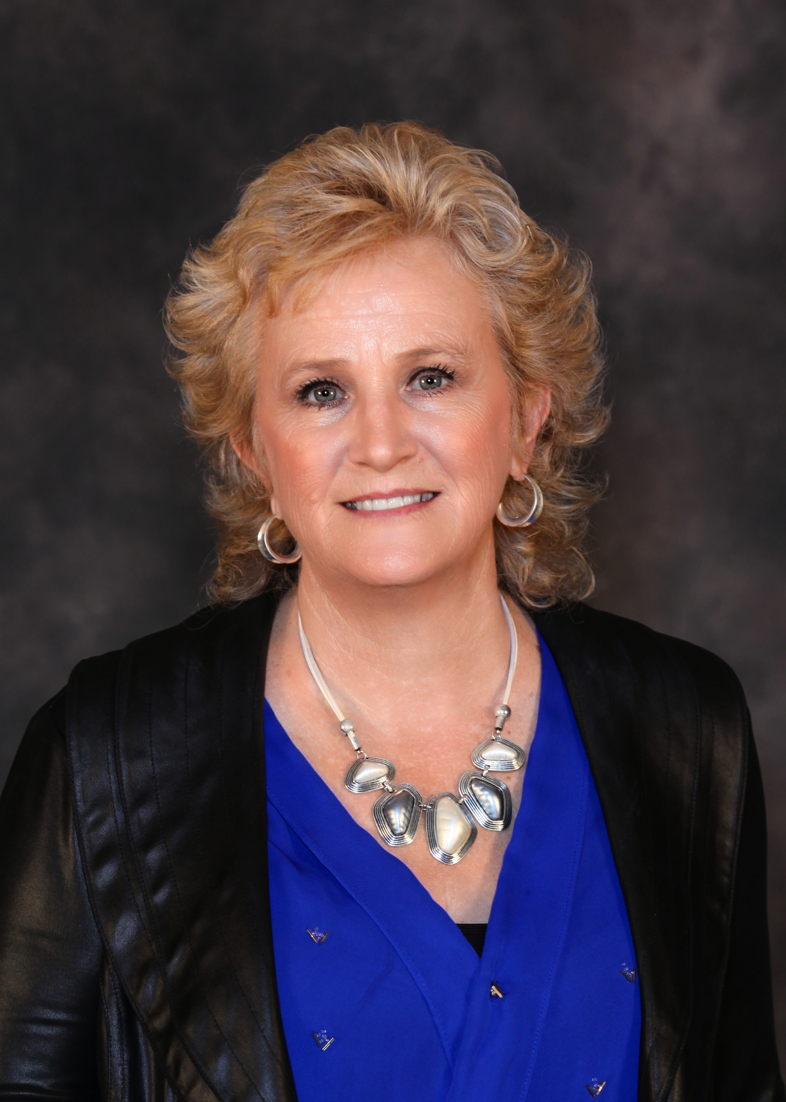

Thanks for Joining Us in this
Educational Journey…
Day Egusquiza, President
AR Systems, Inc
Patient Financial Navigator Foundation, Inc.
PO Box 2521
Twin Falls, Idaho daylee1@mindspring.com
Http://arsystemsdayegusquiza.com
Pfnfinc.com Not-for-profit Foundation
Patient Financial Navigator Foundation, Inc –
A family owned, Idaho-based foundation formed in 2017.
Transforming the hassle factor in healthcare thru
Education.

Slide 19
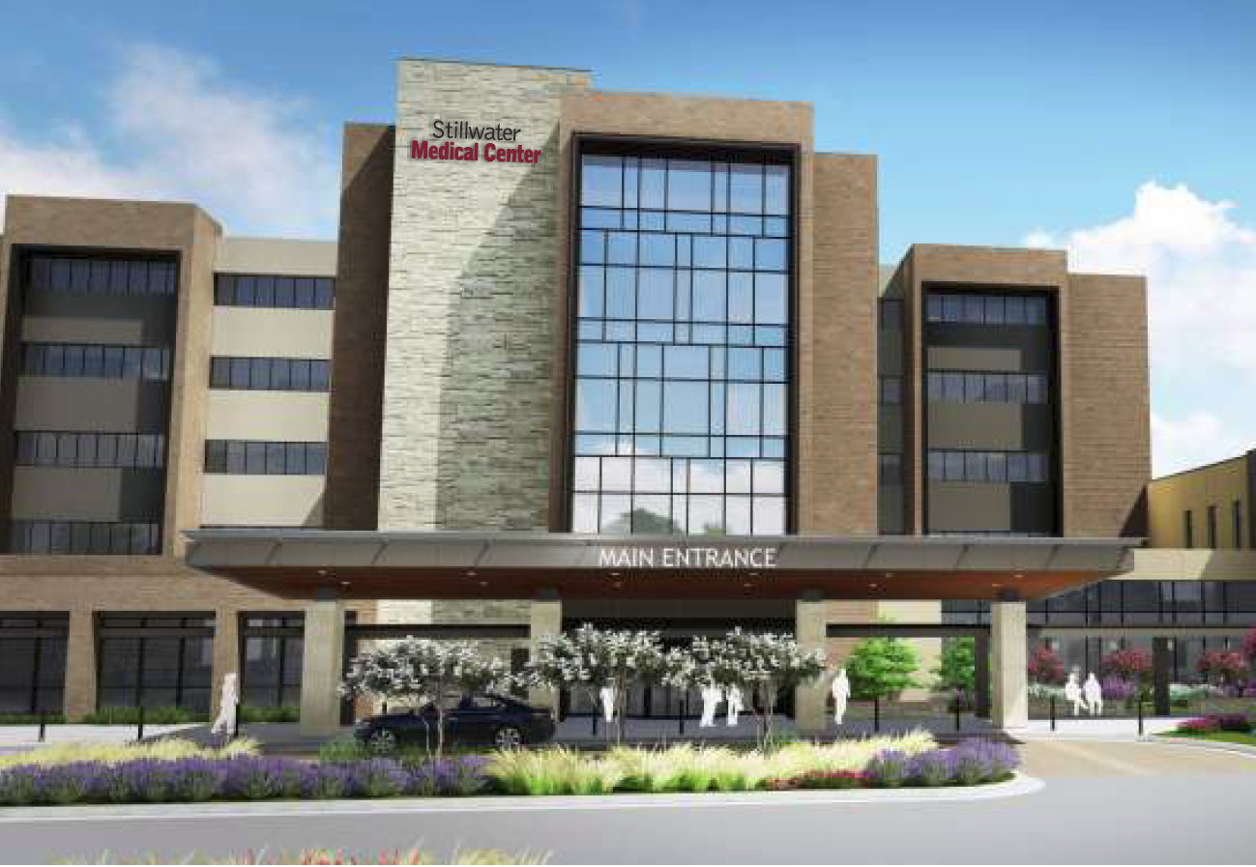
Meet
Stillwater Medical
An independent public trust health system serving north central Oklahoma
117 bed Main Campus Hospital
25 bed rural hospital
50 bed managed hospital
42 service locations
112 + employed providers
1600 employees

Slide 20
Our Focus…Intentional Excellence
Modern Healthcare’s top 100 Best Places to Work – 8 years (3 years in top 25)
IBM Watson Top 100 Hospitals
Health Grades Outstanding Patient Experience Top 15 percent of hospitals
“Together we set our sights on intentional excellence – a heightened awareness of opportunities to surpass the expected and the dedication to see it through”
Denise Webber, CEO
Stillwater Medical

Slide 21
Our Healthcare Disruption Challenges
6 different electronic health records across our health system entities.
Payer authorization delays for patient outpatient testing.
Creating a Consolidated Business Office (CBO) altered the “real time” revenue cycle charge capture, coding and patient account communication within each provider setting.
Patients must navigate multiple portals.
Difficulty closing the loop on physician referrals .
Patient demographics and insurance discrepancies. No “reliable source of truth for patient demographic identifiers” across EHR systems.
Limited Interoperability forces manual workarounds and back-end processing to lessen impact on patients, providers and patient care.

Slide 22
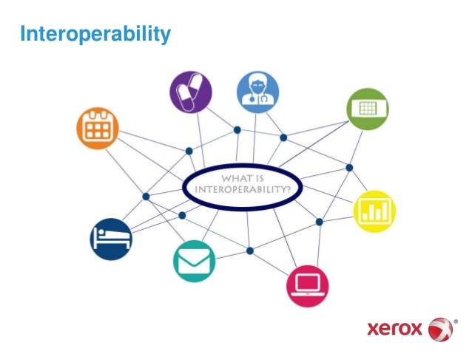
Interoperability???

Slide 23
Interoperability Definition…
As proposed in 2019 by Health Information and Management Systems Society (HIMSS):
“the ability of different information systems, devices and applications to connect within and across organizations”
Stillwater Medical’s Interoperability Objective to reduce healthcare disruption for patients and providers:
“Optimize our existing systems and enhance the ability to share and access patient information across our organization to:
Implement a single patient communication portal
Identify patients across all systems and service areas through a single patient identifier
Optimize business intelligence tools to analyze data across all systems
Seamlessly connect patients, providers, tools and EHRs across Stillwater Medical entities to “close the loop” in the patient care cycle

Slide 24
Provider Information Challenges Become Patient Care Disrupters
Issue: 8-10% of lab results and patient result calls are delayed due to the inability to match key patient identifiers between hospital reference lab and clinic systems.
Solutions in Progress:
Standardize required demographic data captured during scheduling/registration – map fields between systems and align field population to aid in matching and returning test results to various EMRs.
Optimize hospital reference lab process by eliminating multiple mnemonics in lab charge master to allow one-to-one match for CPT on physician order to corresponding test mnemonic in Lab system.
Implement a single patient identifier across Stillwater Medical systems to match patients records, orders, tests and images.

Slide 25
Increase Patient Trust…”Ask One Time”
Issue: In response to patient concerns, A recent Lean Team “Gemba Walk” following patients from ER through ancillary and clinic follow-up visits to specialist and outpatient surgery encounters found that a patient may be asked to repeat demographic, medication and health history information up to 7 times through the continuum of care.
Solutions in Progress:
Enhance our patient focused culture to improve reliability of demographic data across all systems. Identify a single source of truth.
Ensure that any patient medical history updates captured on paper are consistently updated in systems.
Read and acknowledge a patient’s EHR information and ask only clarifying questions.
Configure and implement a single patient portal to be shared across all Stillwater Medical locations/systems for pre-service and post service patient communication, education, results, demographic and medical history updates and schedules.

Slide 26

For Encouragement Anytime:
Tamie Young, FHFMA
Assistant Administrator – Revenue Cycle
tdyoung@stillwater-medical.org
405-533-6097
Stillwater Medical
Stillwater, Oklahoma

Slide 27

Building a Healthier Community

Slide 28

Most Recent Recognition and Awards

Slide 29
Memorial’s Journey
24 Months Ago Today
1 acute hospital
1 Behavioral Health Hospital
Inpatient Rehab
70 practice locations
  Including pediatrics
2 acute hospitals
Sold Behavioral Health Hospital
LLC Partnership with Inpatient Rehab
110 practice locations
  Sold Pediatrics
  Affiliation agreement – NICU
  Added new service lines
    Nephrology
    Ophthalmology
    ENT
3 Nursing Homes
2 surgery centers
1 ambulance service
LLC partnership for PT/OT
Joined an ACO (MSSP)
Notes:
Tell the growth story

Slide 30
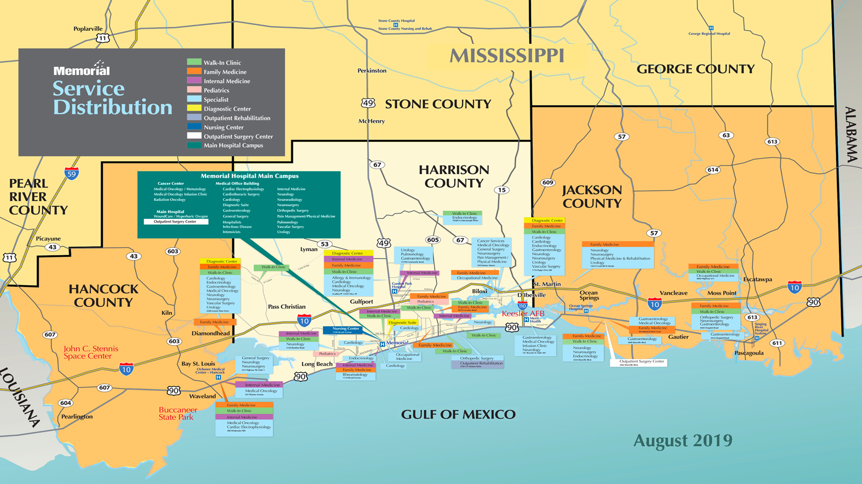
Notes:
So now, this is what we cover, which is phenomenal for our patients, and our community but what Rev Cycle woes do we know face?

Slide 31
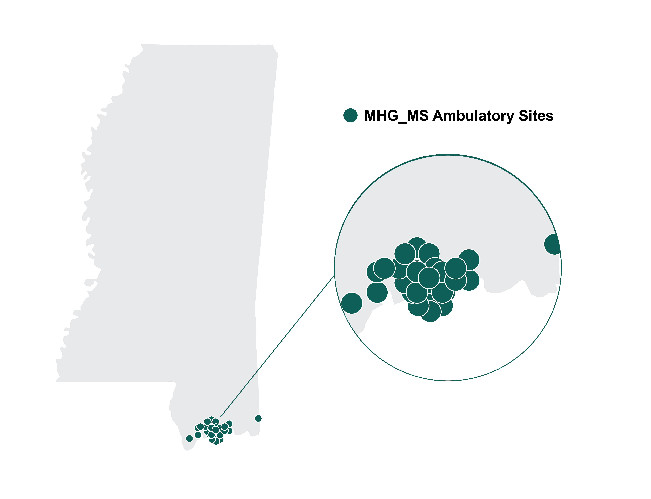
Memorial footprint

Slide 32
About Memorial
Memorial’s Mission is Building a Healthier Community
5K
618
Level 2 Trauma Center
employees
physicians
Not-for-profit safety-net
community hospital established in
1946
100+
Outpatient facilities
15K
348
67K+
160K+
beds
Admissions annually
ED visits
Outpatient visits
50
500K+
334
Nursing Home beds
Operating and
Procedures Rooms
Ambulatory visits
Notes:
Level set so the audience can compare us to them – so again, all of this rapid growth and change, what does it mean for the revenue cycle and for the patients outside of patient care?

Slide 33
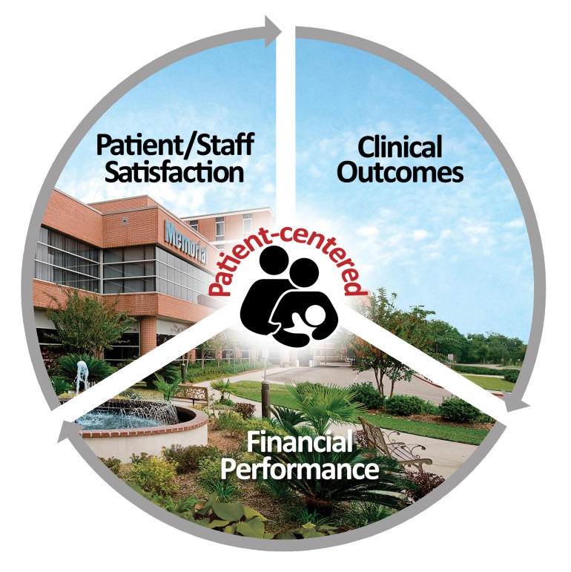
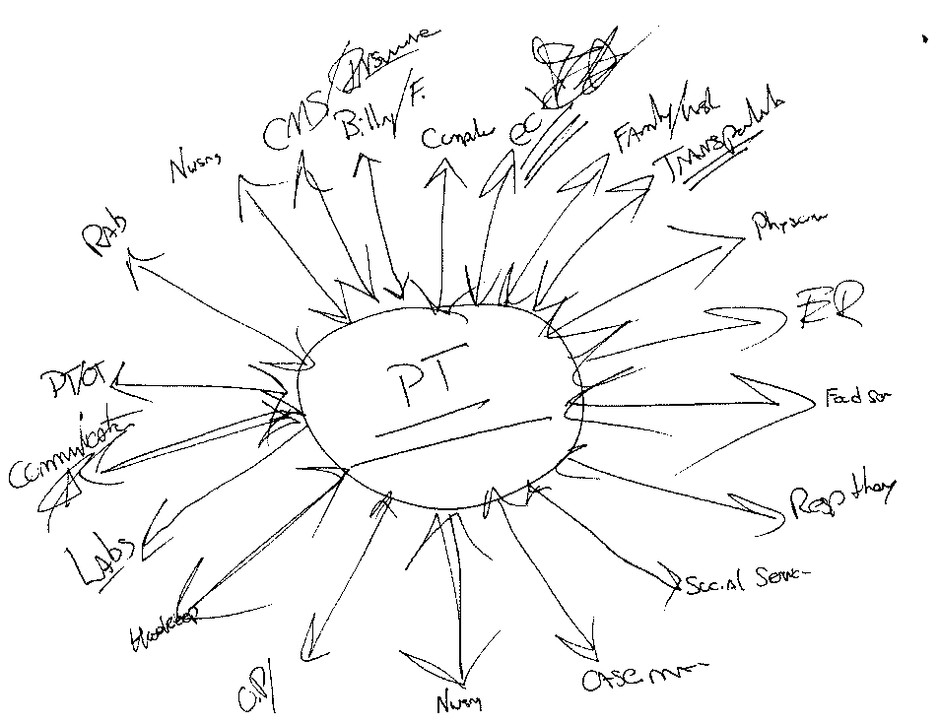
Memorial’s vision
Notes:
So with all of this growth and all of the complications, what is our vision?
Never lose sight of patient centered care and the reason we adopted an EHR. So what are the challenges we are facing and the hassle factors that make this growth difficult to manage for us as well as our patients?

Slide 34
Growing Pains and “Hassle Factors”
Vendor Management
Internal Factors
Patient Factors
Charge master
Payor contracting
855 cash flow delays
Running dual scheduling
Consolidation of contracts
Obtaining health records
Multiple patient portals
How do I pay?
Cost changes by location
Multiple patient portals
EMPI integrity
Employee structure
Retention of qualified RCM staff
Reporting implications
My doctor is now OON
New service location is too far
Customer service transfers for help
How much do I owe everywhere?
AmbulatoryCAC
Cash reconciling
Patient statement redesign
Staff training on new EHR
Prior Auth and OON issues
Interfaces and costs of such
Why are you asking me for my info again?
My OOP is different when I come to you
Do I have to change doctors?
Collections
Referrals
Handling patient transfers
New unchartered service lines
Legacy workdown
Multiple data sources
My statements are different
Why am I getting PBB charges
How come I have to go to you for labs now?
I don’t want to feel like a number
Notes:
There are so many factors to deal with internally, for our vendors and for our patients. It can be completely overwhelming. These are just a few to scratch the surface but they are extremely crucial to deal with and plan for… so what are we going to do about it and what are our plans to address these issues along the way?

Slide 35
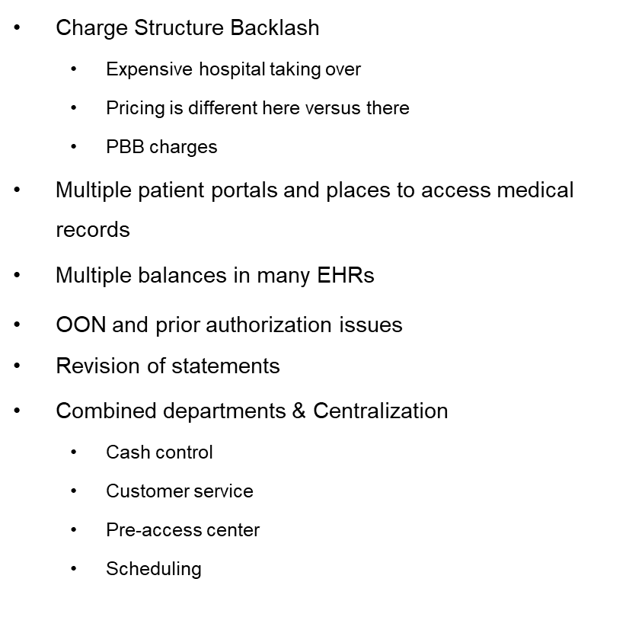
So what are we going to do about it?
Vendor handling a complete CDM overhaul with pricing strategy
  Currently engaged in review
  Package pricing model for cash and high traffic dx testing
Multiple patient portals and places to access medical records
  Looking at integrating to one patient facing portal with multiple back end pointing to make it easy for the patients
Combined departments & Centralization
  Cash control
  Customer service
  Pre-access center
  Scheduling
Working with payors on carve outs for patients who are OON due to acquisitions and developing a marketing strategy for the future (enrollment periods)
Community education outreach and public participation in events

Slide 36
Building a Healthier Community

Slide 37
Memorial Hermann
Patient Experience - A New Journey
November 12, 2019
Steve Hand
AVP - Government Reporting
Notes:
Nothing here just intro

Slide 38



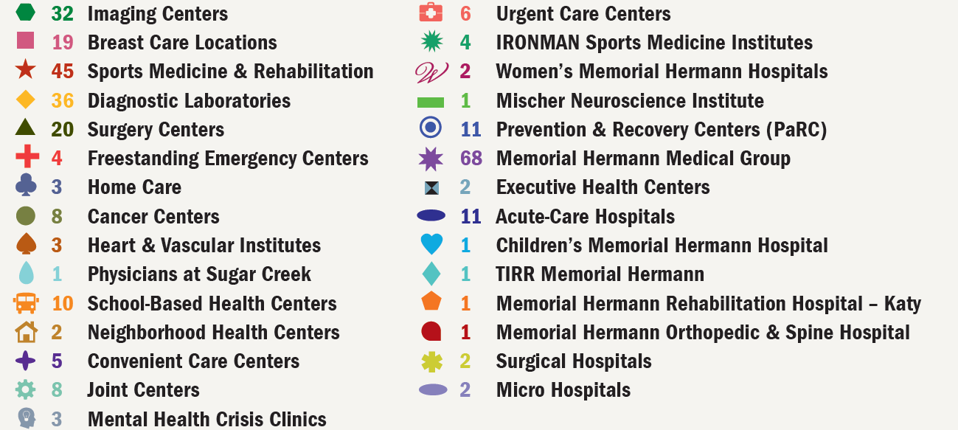



Integrated Delivery System
300+ Care Delivery Sites
One Memorial Hermann
Notes:
MH is the largest Not-For-Profit Community owned Health system in the Southeast Texas. We serve all of Houston and the better part of 3 counties
There are over 300 care deliver sights, ( there is a map but it crazy when you try to see them all on one document )
Memorial Hermann TMC our level 1 Trauma / Transplant/ UTHSC teaching Hospital is our Flagship, along with network of strong community hospitals and many OP locations taking care of over 1/3 of the Greater Houston Market.

Slide 39








Award-Winning Services
Heart & Vascular
Neuroscience
Children’s
Trauma
Orthopedics
Women’s
Oncology
Primary Care
Notes:
We are organized by service lines. These are our Macro service lines, we do have sub-specialty service lines within most of these.
We believe that this type of focus is what allows us to squeeze out the best of the best and make it our system standard.
Wonder if I can say here that we have begun to look at all campuses and adjust the focus when needed. We want to steer our patients to the centers of excellence within our system.
We have also begun the process of removing some services on some campuses to better serve the community. ( i.e. not all campuses do high level trauma, and not all do OB Deliveries. )

Slide 40












Key Accomplishments
2019
2019
Notes:
Here are some of the awards from the most recent years.

Slide 41
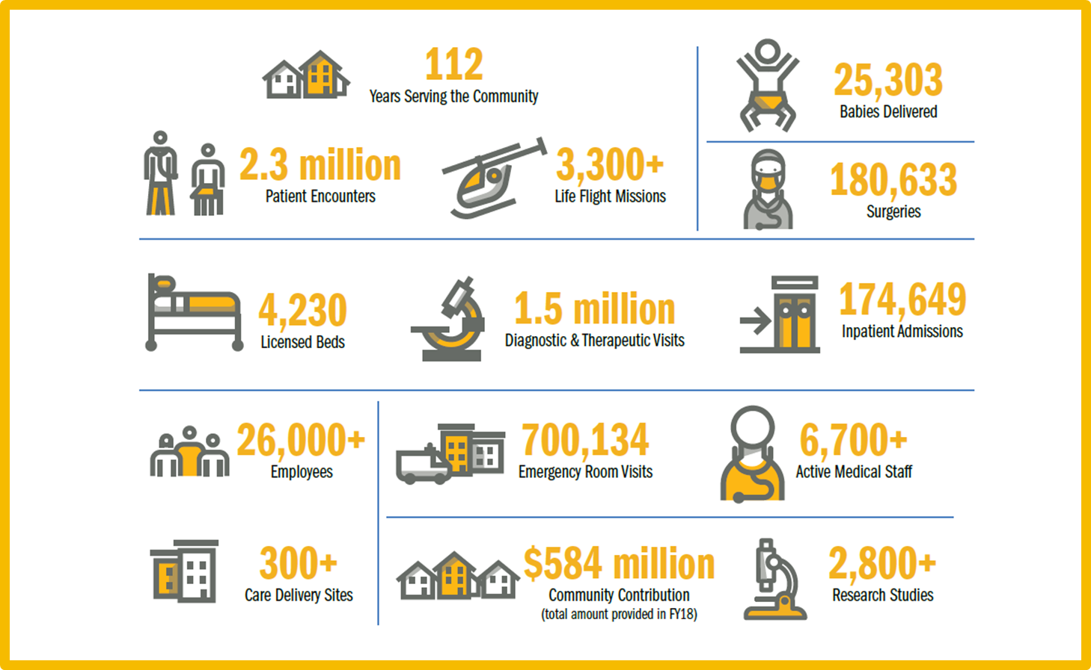
By the Numbers
Heart & Vascular
Neuroscience
Trauma
Orthopedics
Women’s
Oncology
Primary Care
FY19 data
Notes:
We are organized by service lines. These are our Macro service lines, we do have sub-specialty service lines within most of these.
We believe that this type of focus is what allows us to squeeze out the best of the best and make it our system standard.
Wonder if I can say here that we have begun to look at all campuses and adjust the focus when needed. We want to steer our patients to the centers of excellence within our system.
We have also begun the process of removing some services on some campuses to better serve the community. ( i.e. not all campuses do high level trauma, and not all do OB Deliveries. )

Slide 42

The Customer Experience Journey
With current delivery footprint, the decision was made: we need a fresh approach and a dedicated resource
  The creation of the new position SVP, Chief Consumer Experience Officer (Alex Greengold, from outside Healthcare, - Communication Background - VP over customer experience)
  Alex is in the onboarding process and is working his way through all levels of the organization studying what we do and how
Identifying challenges
  So many different systems, multiple EMRs (Athena, Cerner, Allscripts and Epic )
  They don’t share information easily and it is hard to follow the consumer
  Scheduling is way too difficult; we need this to be digital, much like the Open Table concept
  Registrations, while we are paperless at most locations, our goal is to be 100% paperless
  Strategy to remake the Journey for example: 9-mth pregnancy, office visits, text & email updates, hospital visit, Netflix and Phone chargers in each room, make technology work for the patient’s convenience
Notes:
Now that you know about our
Patient care
Good clinical models, great outcomes, many awards
Let's look at our
Financial Care
Renewed emphasis here, typically Finance is the first and last touch points in our system. We want to have excellent customer care. We can’t have Great Clinical Care and have the ball drop here.
The challenges
Multiple EMRs ( Athena, Cerner, Allscripts and Epic)
We want to be collaborative and highly engaged with our partners
We have electronic paperless registration at most all sights but not 100%
We have had on-line scheduling for several years (not real time, requires manumation )

Slide 43


Touch Points, Processes, and Software
Looking at current systems and new products
Patient Portal - enterprise wide
Everyday Well - tracking Health updates
Scheduling - dynamic full scope system
Create Customer Communication Preference system
  Phone call
  On-line / Mobile
  Text
  Other
Notes:
The Journey
In the beginning scheduling was all manual. Nothing but calls and a roster of open slots to coordinate with Doctors, Patients, clinical departments and Insurance pre-Certifications.
Implementation of on-line scheduling system. Helpful to the consumer but not really connected to the actual Inventory. Would allow you to pick a slot, only to send e-mail to the scheduling area to coordinate and actual block the time. If time wasn’t available, you had to call the patient back and work to find an opening that would be acceptable.
Next step is the Consumer Communication Preference profile. Dealing with varying levels of consumers, one model will not work for everyone. This will allow the consumer to select the mode of communication they prefer: e-mail, text, phone call or US Mail.
Build a real time scheduling system that works actual inventory, eliminate the manumation.
We have had on-line bill pay for some time, but this is being looked at too.
We have had everyday well for some time, but this is being looked at too.
We want to get to the concierge service level. Goal would be for consumer to complete registration on-line and when they present for services, it is just a matter of pulling up their reservation and checking them in.

Slide 44
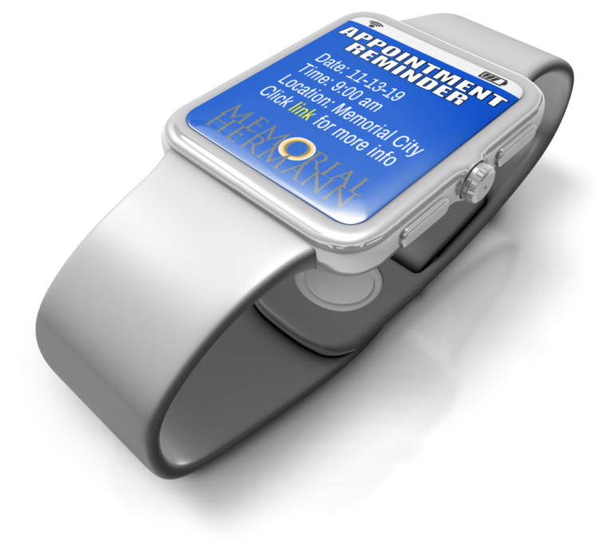




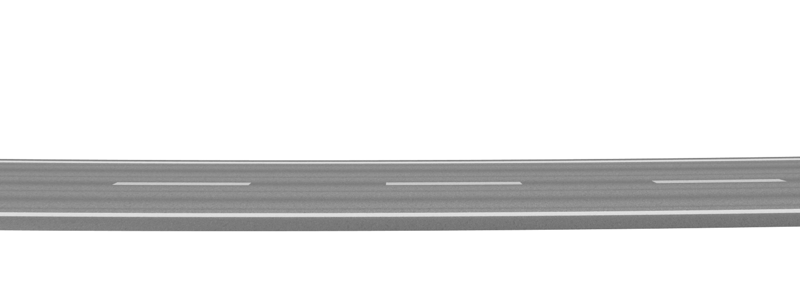
The Journey – Digital Options and Personalized Care
Digital experience journey
  Technology progresses quickly; healthcare is often slow to respond
    Move from manual entry for each episode to sharing data across multiple platforms (physician, hospital, various EMRs) and elimination of redundant questions
    Allow patient to schedule online, upload insurance card, and enter information
  Focus on real-time integration and automation; move away from “manumation”
  Provide patients with an exceptional financial care experience with an excellent clinical experience

Slide 45
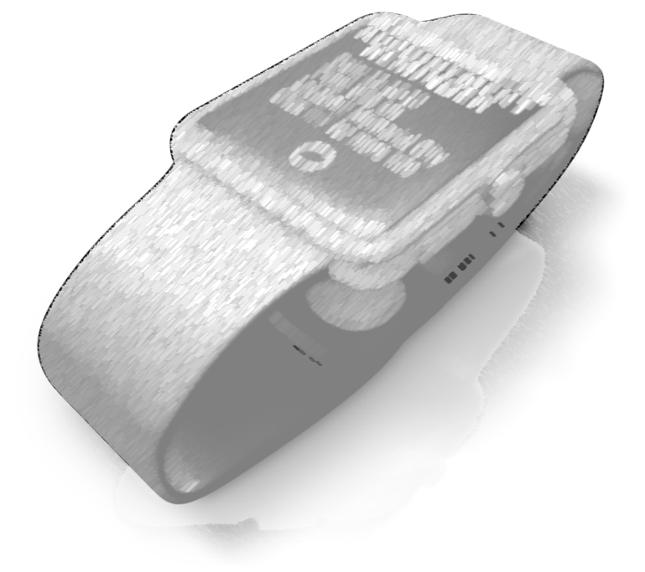


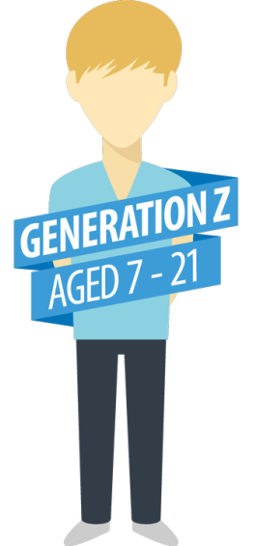




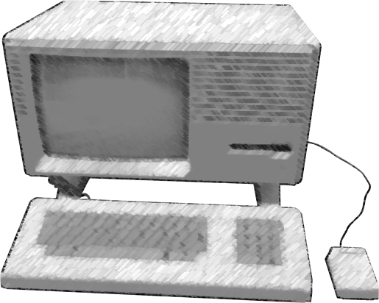


The Journey – Digital Options and Personalized Care
Personalized care journey
  Provide the personalized care that the patient wants – patient preference
  Use technology to create operational efficiency to enable flexibility – concierge service
  Integrate financial and clinical care patient experience

Slide 46

Conclusion
This will be hard work and will require taking time away from very busy individuals
However, if done right will differentiate you from your competitors
Whole process will become more efficient - you will have the time to send with those who need the extra assistance as all your millennials are completing everything on line ahead of their presentation
Builds brand loyalty, which is tough in today's Healthcare environment
Stay diligent and work to identify any pain points and eliminate the red tape
Thank you - will be glad to come back next year and share the progress made
Notes:
Mostly just read the slide

